Slide 1
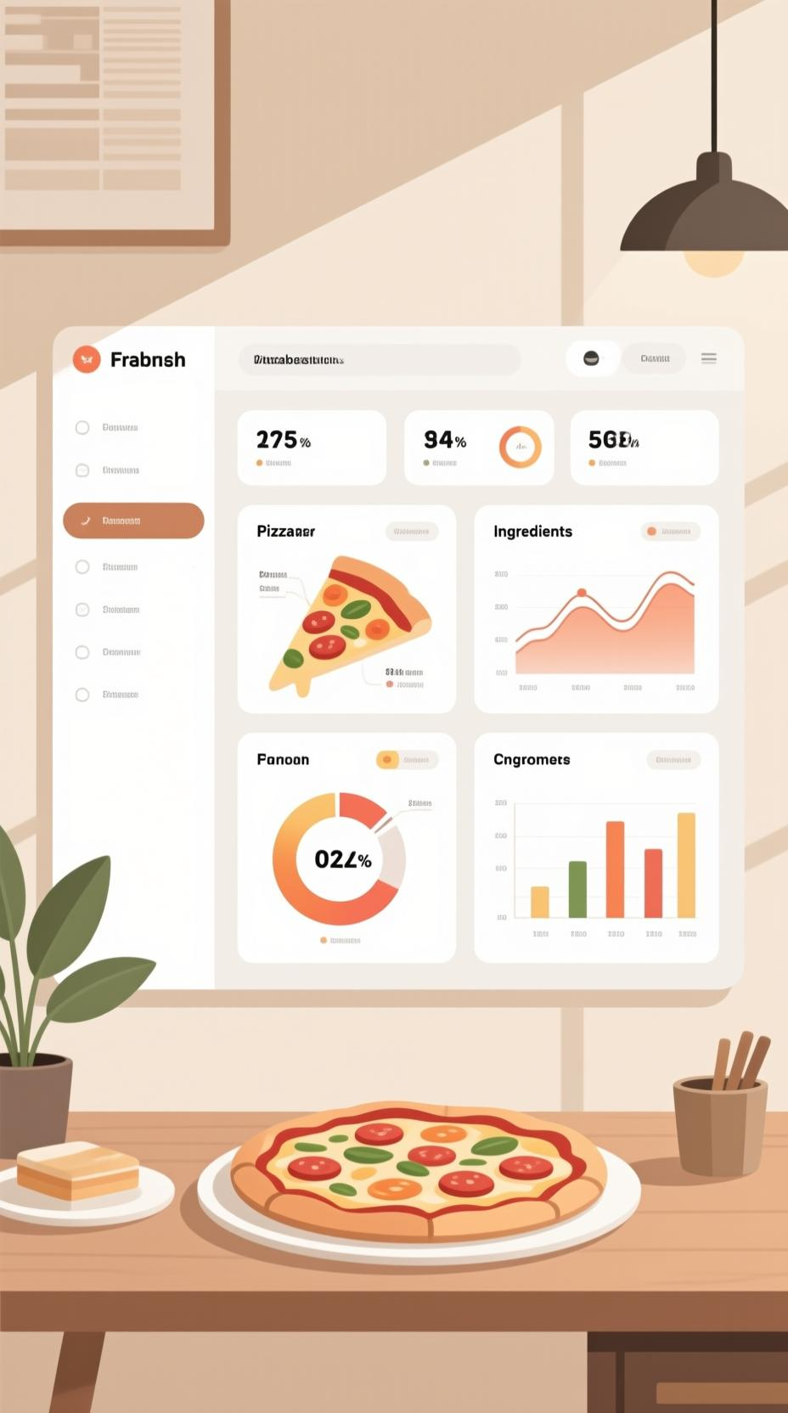
SQL Pizza Analytics Insights
A comprehensive analysis of pizza sales data using SQL queries to uncover key business metrics, customer preferences, and operational patterns for data-driven decision making.

Slide 2
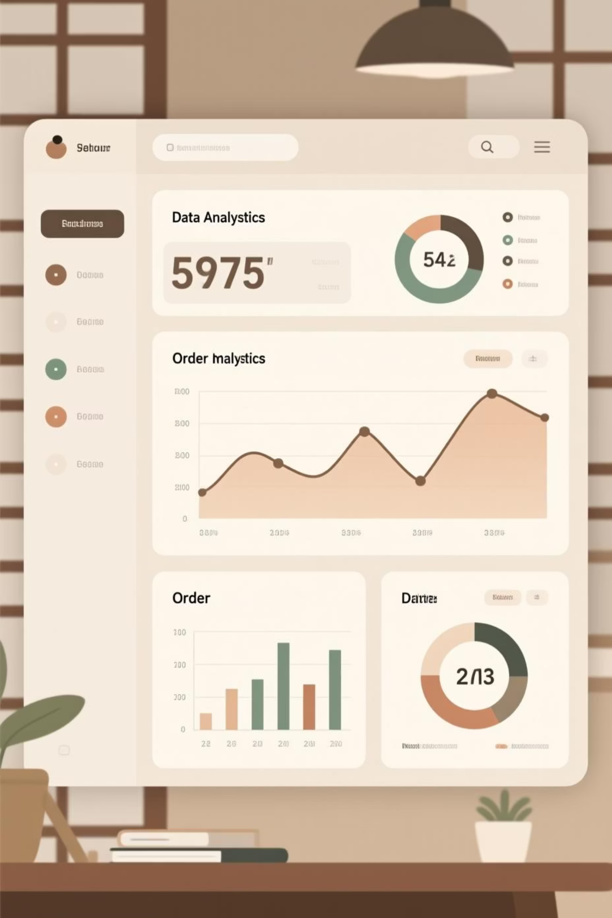
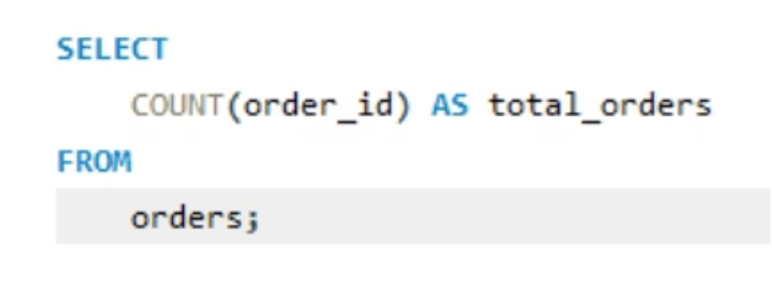
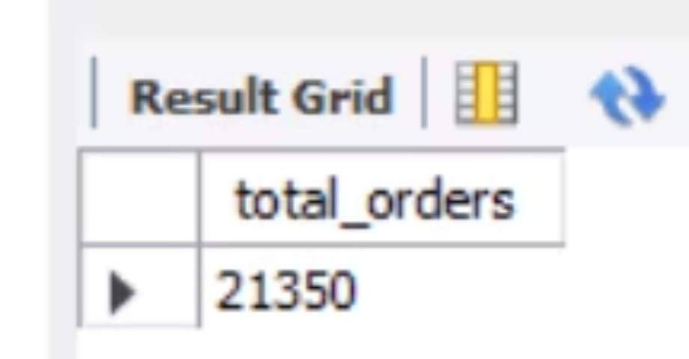
Retrieve the Total Number of Orders Placed
Understanding the total volume of orders is the foundation of any sales analysis. This fundamental metric provides insight into business activity levels and helps establish baseline performance indicators for further analysis.

Slide 3




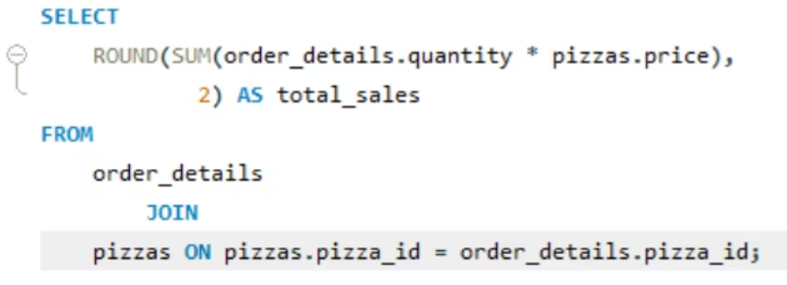
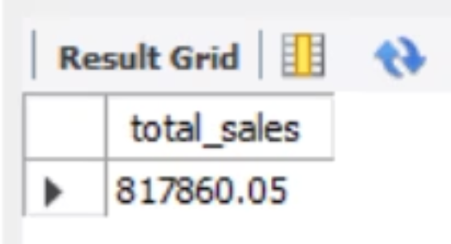
Calculate Total Revenue from Pizza Sales
Revenue Calculation
Query Logic
Aggregate all sales transactions to determine total income generated from pizza orders
Join order details with pricing data to compute comprehensive revenue figures
Business Impact
Revenue metrics drive strategic decisions and performance evaluation

Slide 4

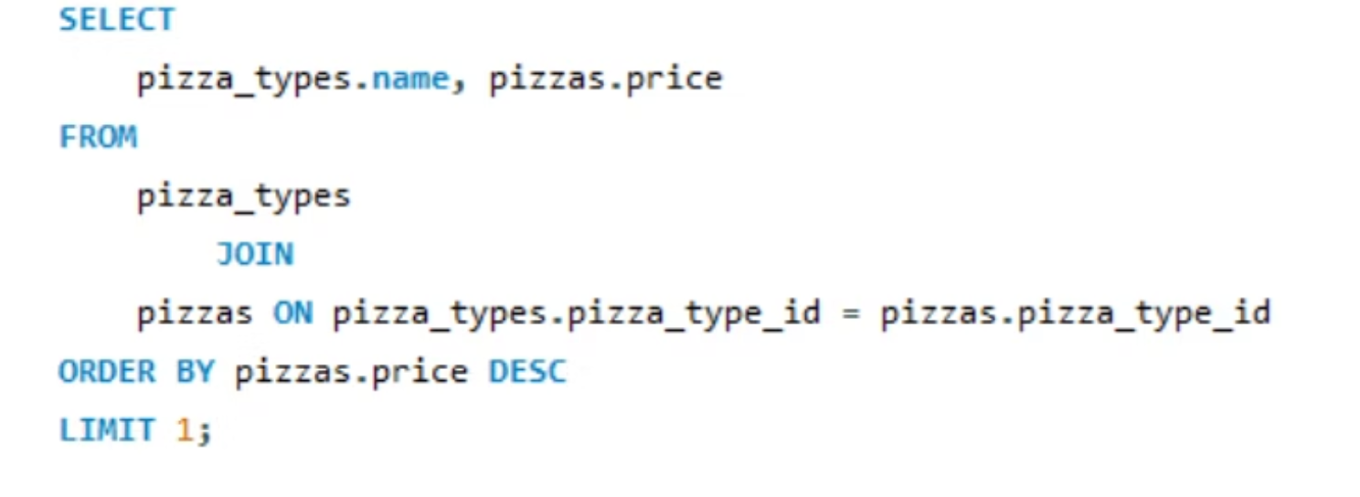
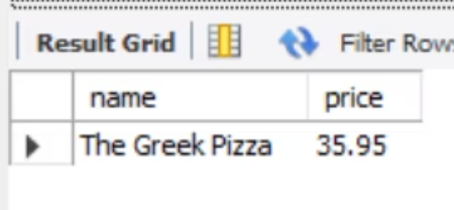
Identify the Highest-Priced Pizza
Premium Product Analysis
Identifying the highest-priced item reveals premium product positioning and helps analyze customer willingness to pay for specialty offerings. This metric is essential for pricing strategy optimization.
Query the pizza menu table for maximum price
Return pizza name and associated price point
Consider size variations in pricing structure

Slide 5



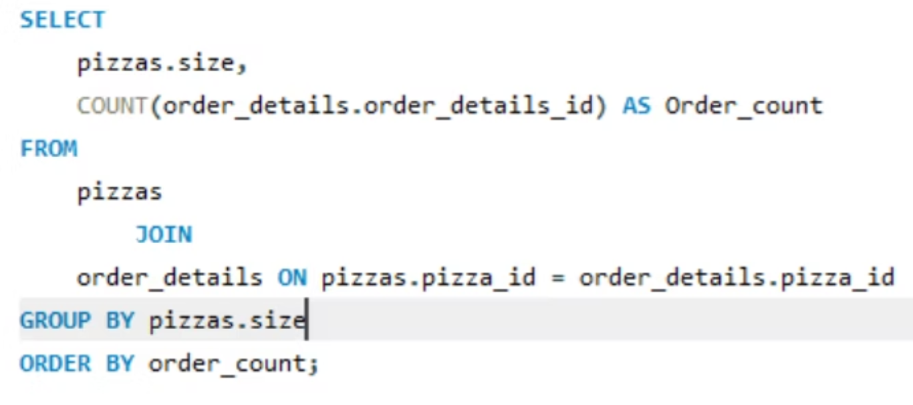
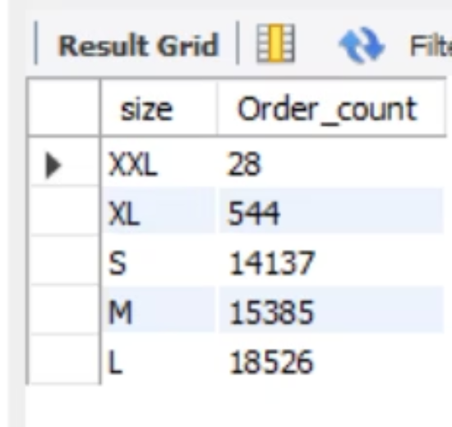
Most Common Pizza Size Ordered
45%
35%
20%
Large Pizzas
Medium Pizzas
Small Pizzas
Most popular choice for group orders
Balanced option for small families
Individual and personal portions
Understanding size preferences helps optimize inventory management, production planning, and promotional strategies. This analysis groups orders by size and counts frequency to determine the most popular option.

Slide 6

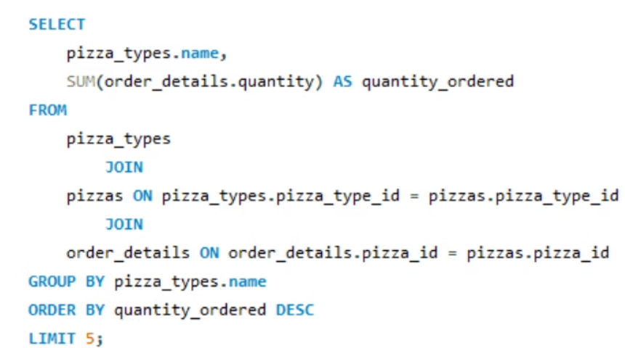
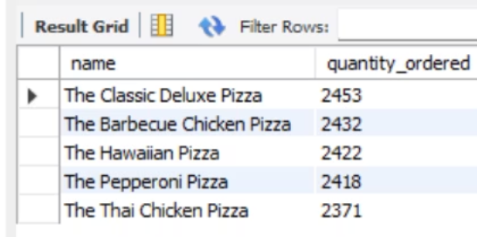
Top 5 Most Ordered Pizza Types
01
02
Aggregate Order Data
Sort by Popularity
Group orders by pizza type to calculate total quantities for each variety
Rank pizza types in descending order based on quantity ordered
03
Extract Top 5
Limit results to the five most popular pizza types for focused analysis
This ranking reveals customer preferences and helps inform menu optimization, ingredient purchasing, and marketing focus areas. Understanding bestsellers is crucial for operational efficiency.

Slide 7
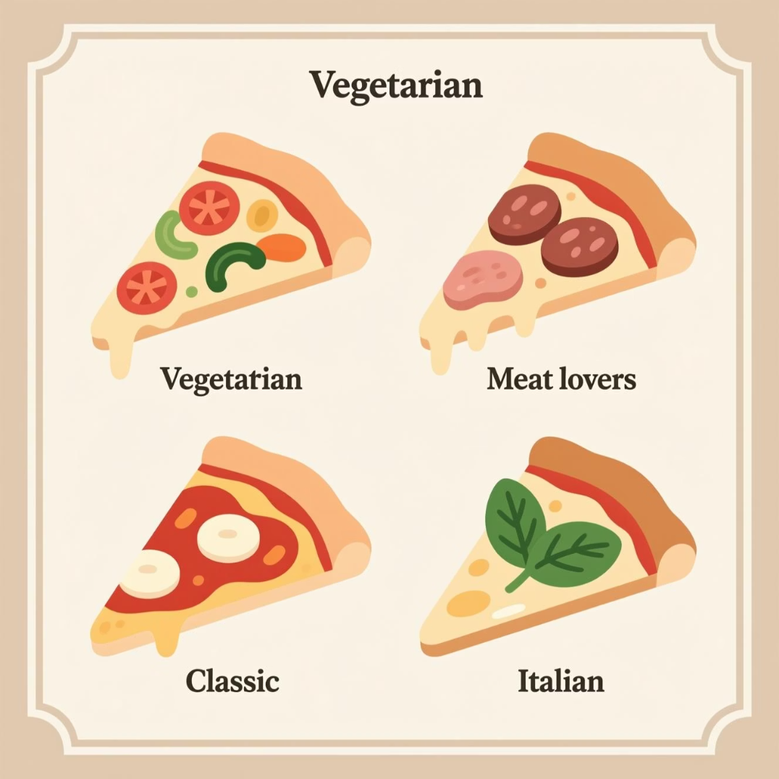

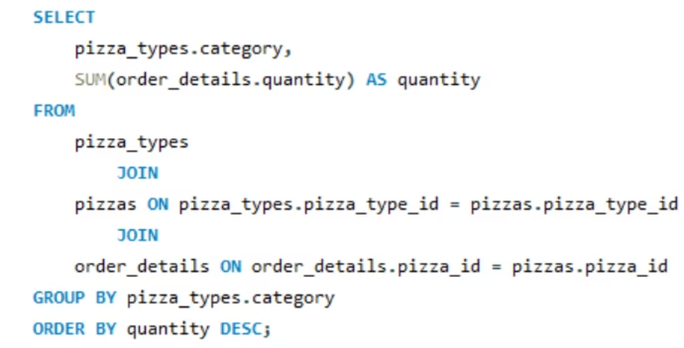
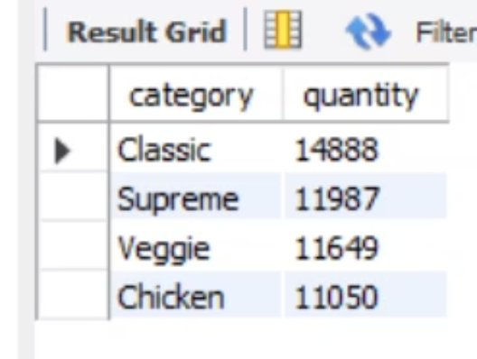
Total Quantity by Pizza Category
Category-Level Insights
By joining order details with pizza type tables, we can aggregate quantities at the category level. This broader view helps identify trends beyond individual products.
Key Benefit: Category analysis reveals customer preferences for meat-based, vegetarian, or specialty pizzas, informing menu development strategies.

Slide 8

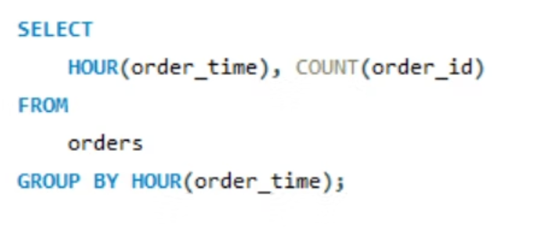
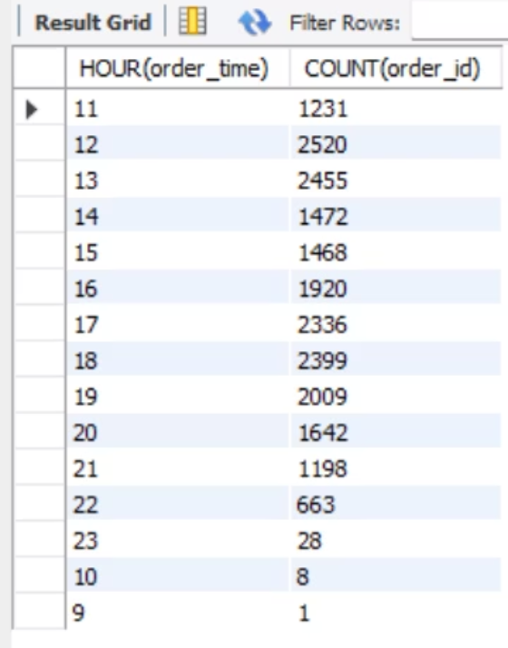
Order Distribution by Hour
1
11 AM - 1 PM
Lunch rush peak
2
1 PM - 4 PM
Afternoon lull period
3
5 PM - 8 PM
Dinner peak hours
4
8 PM - Close
Evening tapering
Analyzing order patterns by hour of day enables optimal staff scheduling, kitchen preparation timing, and delivery resource allocation. Extract the hour from order timestamps and group to reveal peak demand periods.

Slide 9








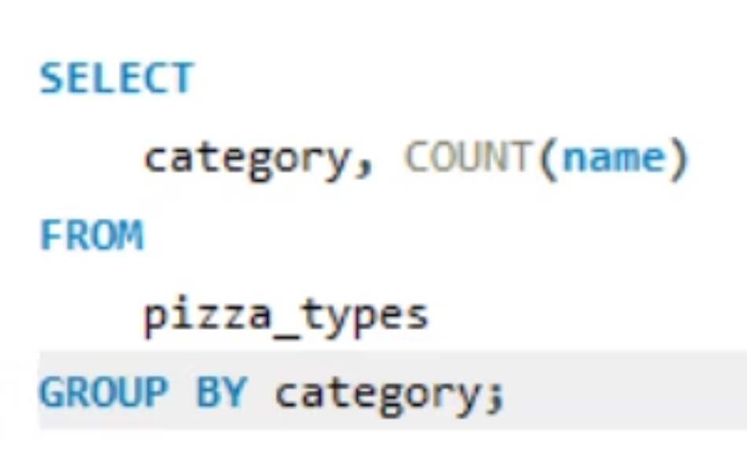
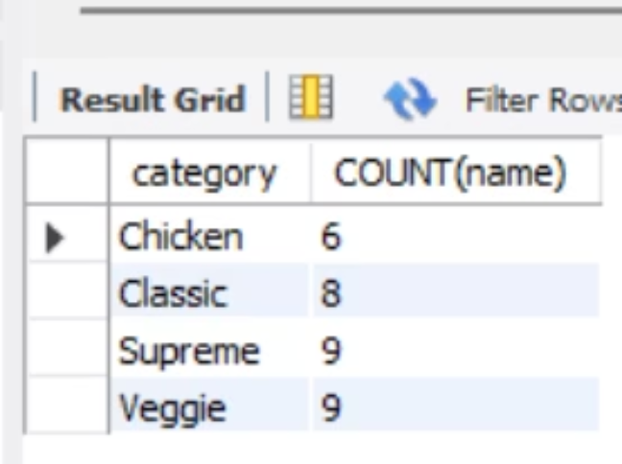
Category-Wise Pizza Distribution
Chicken
Veggie
Poultry-based specialty pizzas with diverse topping combinations
Plant-based options featuring fresh vegetables and herbs
Supreme
Classic
Premium combinations with multiple toppings and ingredients
Traditional favorites like Margherita and Pepperoni

Slide 10

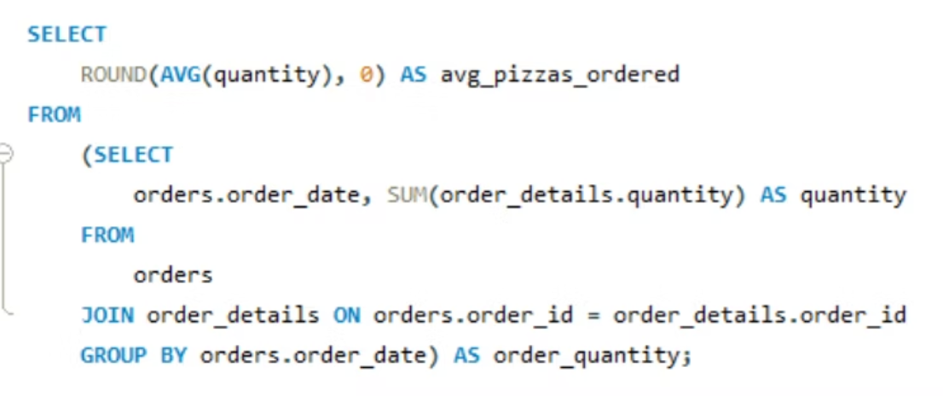
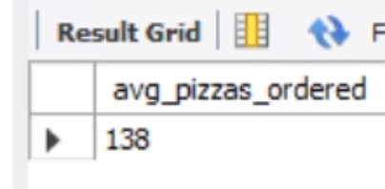
Average Pizzas Ordered Per Day
Daily Volume Analysis
Grouping orders by date and calculating average daily pizza volume provides a normalized metric for comparing performance across different time periods.
This analysis smooths out day-to-day variations and reveals underlying trends in customer demand patterns.
138
7
24%
Average Daily Orders
Days Analyzed
Weekend Increase
Typical volume across all days of operation
One full week of operational data
Higher volume on Friday through Sunday

Slide 11

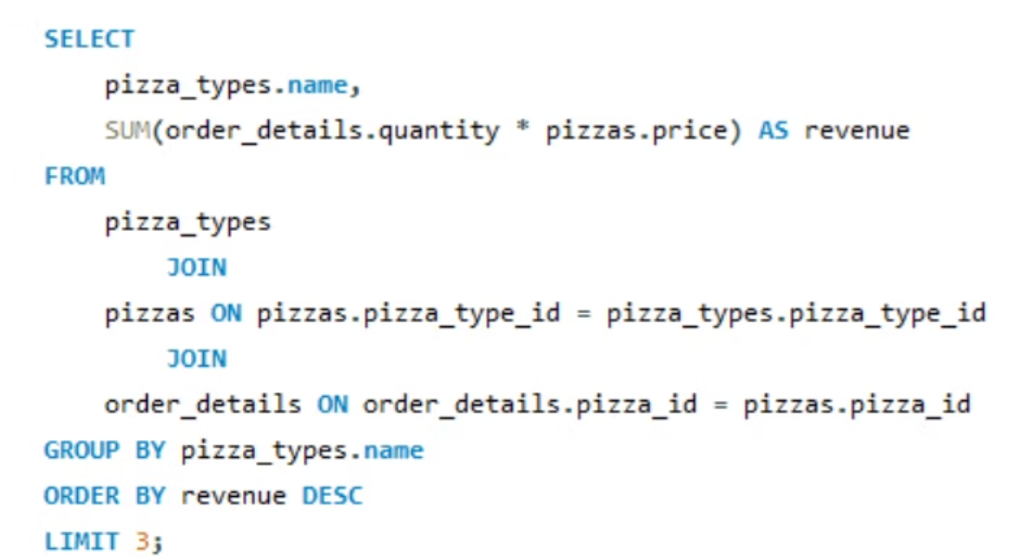
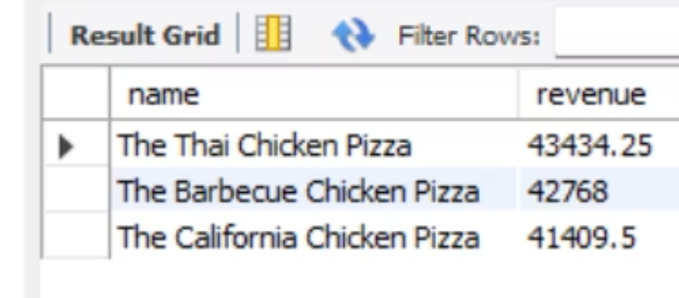
Top 3 Pizza Types by Revenue
🥇 First Place
🥈 Second Place
The highest revenue-generating pizza combines popularity with premium pricing, representing the sweet spot of customer demand and profitability
Strong performer balancing volume and price point, appealing to a broad customer base while maintaining solid margins
🥉 Third Place
Consistent contributor to overall revenue, often a classic favorite with reliable repeat purchase patterns
This revenue-based ranking differs from pure quantity rankings by accounting for price variations. It identifies which products drive the most financial value, not just volume. Join order details with pricing and pizza type data, calculate total revenue per type, and rank accordingly.

Slide 12

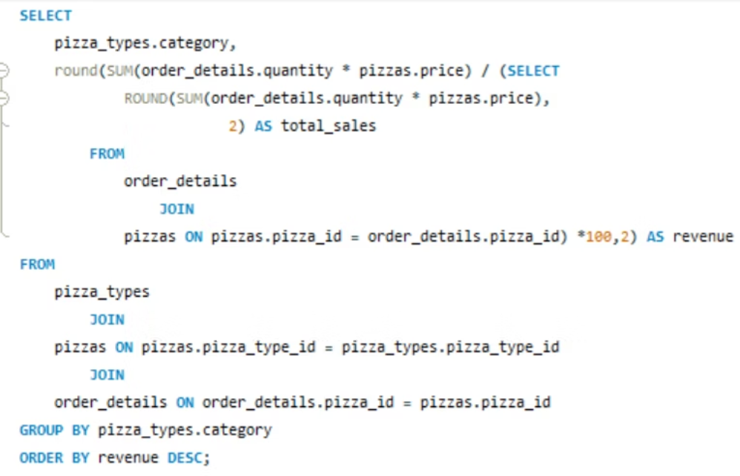
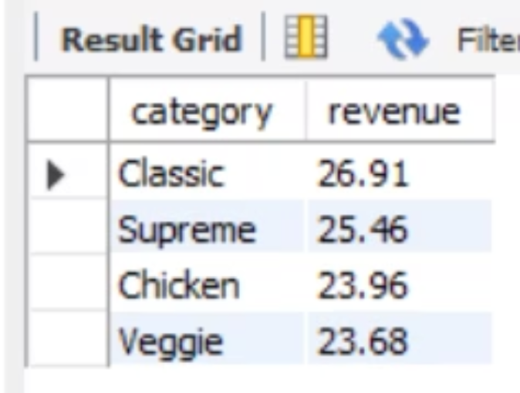
Revenue Contribution by Pizza Type
Understanding which pizza types drive the most revenue is essential for optimizing menu offerings and inventory management. This analysis breaks down the percentage contribution of each pizza type to total revenue, helping identify your most profitable products and guide strategic decisions about pricing, promotion, and menu development.
Key Insights
The Thai Chicken Pizza leads revenue contribution at 20.4%
Classic pizzas dominate the top revenue positions
Specialty varieties show strong performance in the mid-range

Slide 13




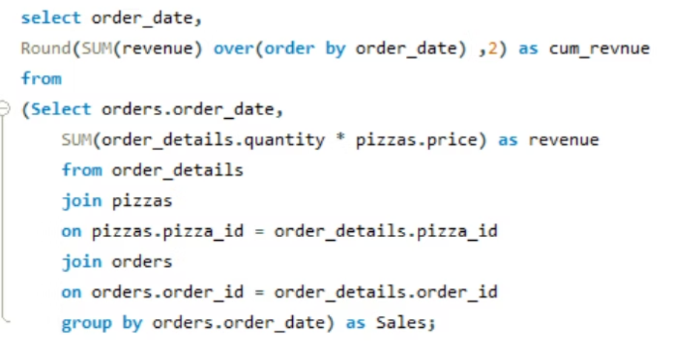
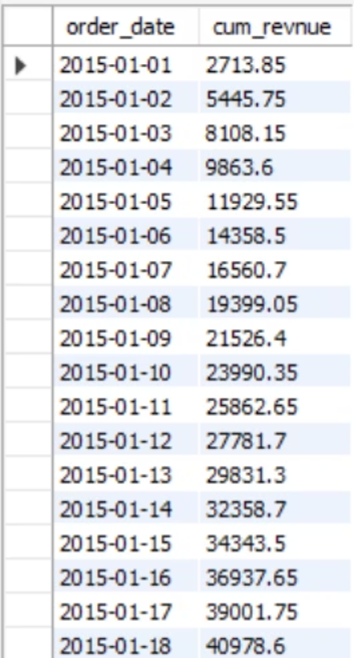
Cumulative Revenue Growth Trends
Tracking cumulative revenue over time reveals crucial patterns in business performance, seasonal fluctuations, and growth trajectory. This temporal analysis helps identify peak periods, understand customer behavior patterns, and forecast future revenue streams with greater accuracy.
Growth Acceleration
Seasonal Patterns
Monitor the rate of revenue accumulation to identify periods of rapid growth and potential slowdowns.
Recognize recurring trends that align with holidays, weather changes, or promotional campaigns.
Revenue Milestones
Track progress toward annual goals and benchmark performance against previous periods.

Slide 14
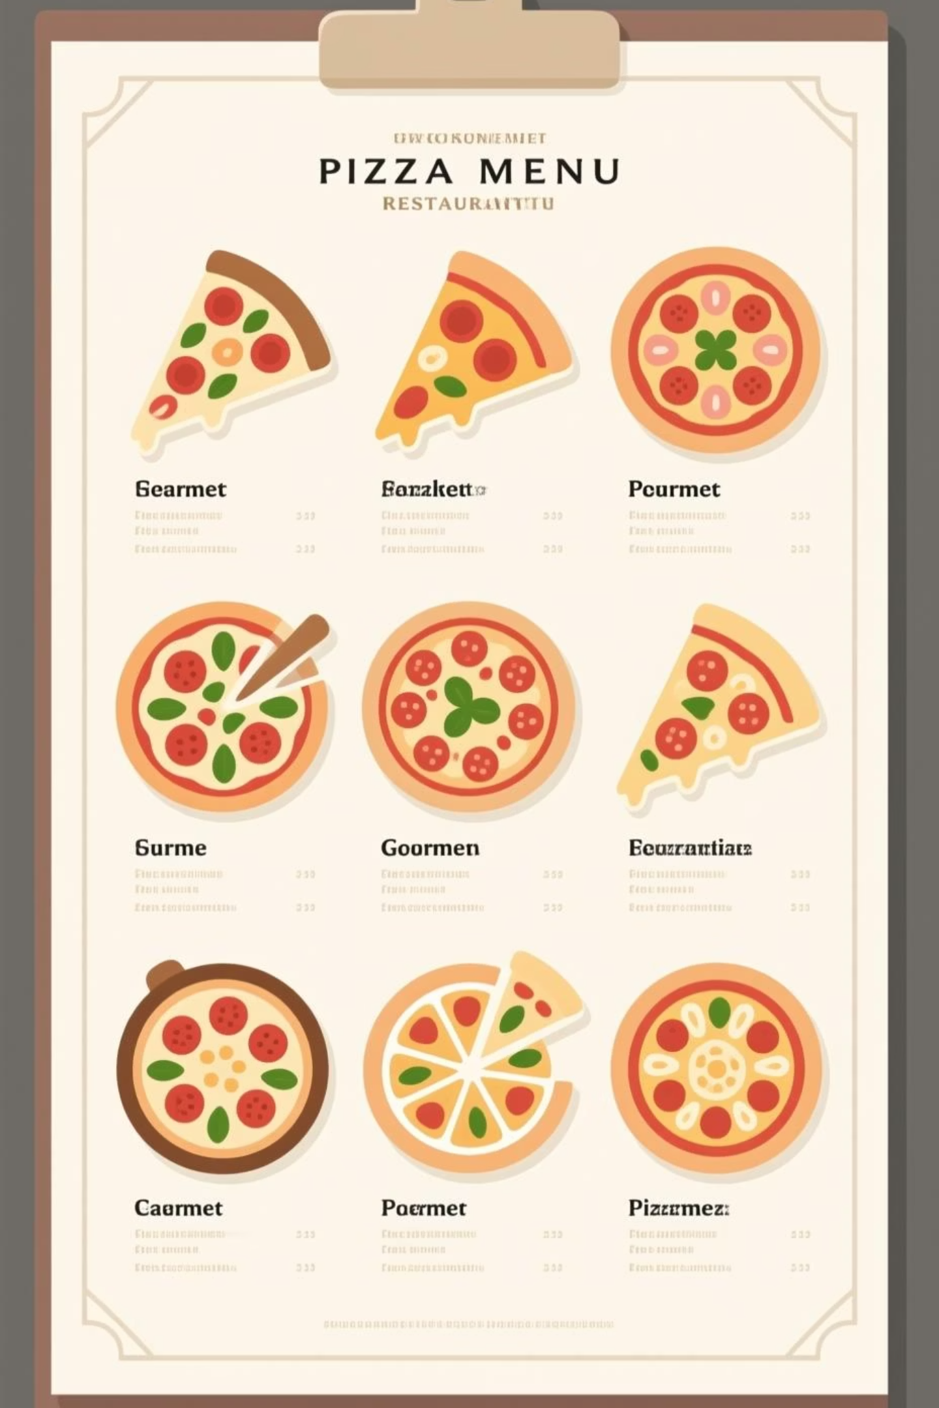
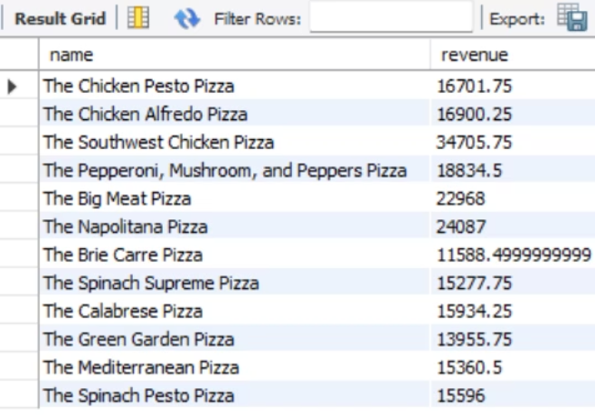
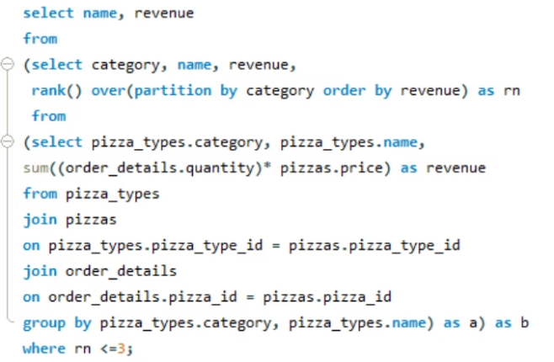
Top Revenue Performers by Category
Identifying the top 3 most ordered pizza types within each category provides actionable intelligence for menu optimization. This granular analysis reveals which specific products resonate most with customers in each category, enabling data-driven decisions about inventory allocation, staff training priorities, and targeted marketing efforts.

Slide 15
Key Takeaways & Next Steps
Revenue Concentration
Temporal Intelligence
Category Strategy
A small number of pizza types drive the majority of revenue. Focus resources on maintaining quality and availability of these high-performers while testing innovations carefully.
Cumulative revenue trends reveal critical insights about seasonality and growth patterns. Use this data to optimize staffing, inventory, and promotional timing for maximum impact.
Each pizza category has distinct top performers. Tailor your marketing and operations strategy to highlight these winners while strategically phasing out underperformers.
Recommended Actions
Optimize Menu
Adjust Inventory
Monitor Trends
Prioritize top revenue-generating pizzas in prominent menu positions and promotional materials.
Align ingredient purchasing with demand patterns identified in the revenue analysis.
Establish regular review cycles to track performance shifts and respond quickly to changes.

